Slide 1
Migrating .NET applications to Azure

Slide 2






Why migrate from on-prem to Azure?
Optimized costs
Backup, recovery, and failover
Flexibility and scalability
Compliance
Enhanced security
Simplified management and monitoring
and many more…
Notes:
Cost:
You can save money on resource, maintenance, and real estate costs by paying only for the cloud resources that you use. You can also optimize your workloads to run more efficiently and cost-effectively on Azure. Whatever you use occasionally – you pay only when you use it.
Flexibility:
When demand spikes or goes down – you can alter your resources instantly on demand.
You can also run your workloads closer to your users by using Azure’s global network of datacenters
Security:
Azure provides built-in security features and tools to help protect your applications and data.
Security patching is done automatically by Azure in many cases.
Backup
You can easily backup and recover your apps with Azure. For extra protection, you can even store your backups in different geographic regions.
Compliance
If your app has compliances requirements, Azure offers solutions for that for various industries, such as finance, healthcare, government, etc.
Management
You have a single dashboard to manage and monitor all your resources. There are also Azure services to gain insights and analytics for your apps.

Slide 3

How migration process looked like before?
1. Business decision
2. Overall evaluation
3. Engineering work
moving apps to Azure

Slide 4
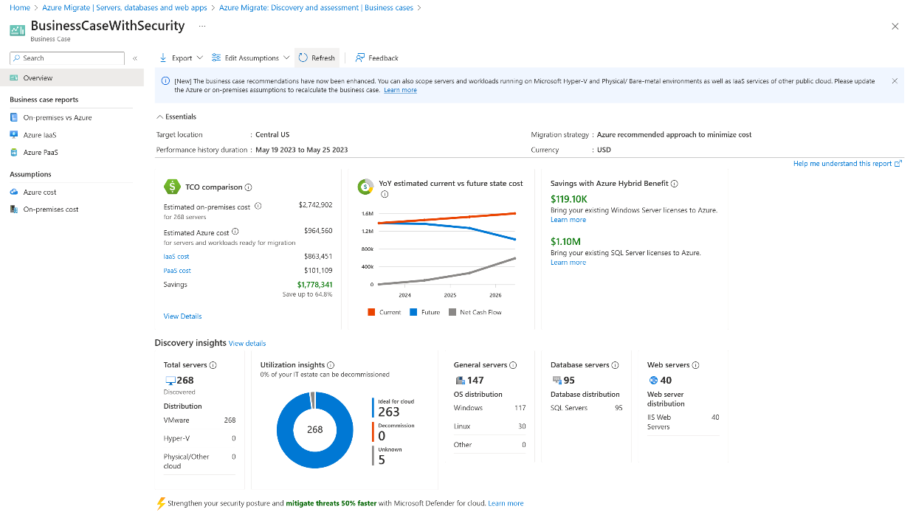
Azure Migrate (experience before)
Agent-based VM and application discovery
Scenario: high-level VM config and large applications scan
Users: IT ops, dev ops, people who manage the IT portfolio with minimal exposure to source code
Benefits:
scans the entire portfolio of VMs and # of apps
discovers ASP.NET and Tomcat apps by it’s config files
conducts migration (if minimal or no code change required)

Slide 5
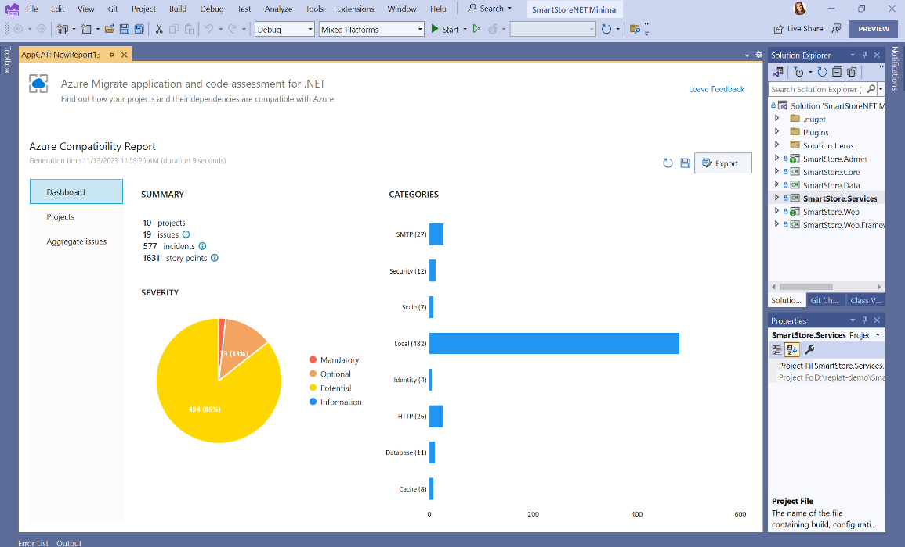
Application and code assessment (new)
Offline code and application assessment
Scenario: detailed application and code scanning
Users: developers, dev leads, product owners, people who manage the source code
Benefits:
Scans the projects and source code written in .NET
Discovers and assesses .NET apps and provides recommended code changes
Produces reports and allows to track incidents progress

Slide 6









Examples of dependencies identified
Database
File system
Network resources
Authentication
Windows Identity
SMTP
Message queues
Caching
Session state
Secret management
Non-HTTP protocols
Application Request Routing

Slide 7
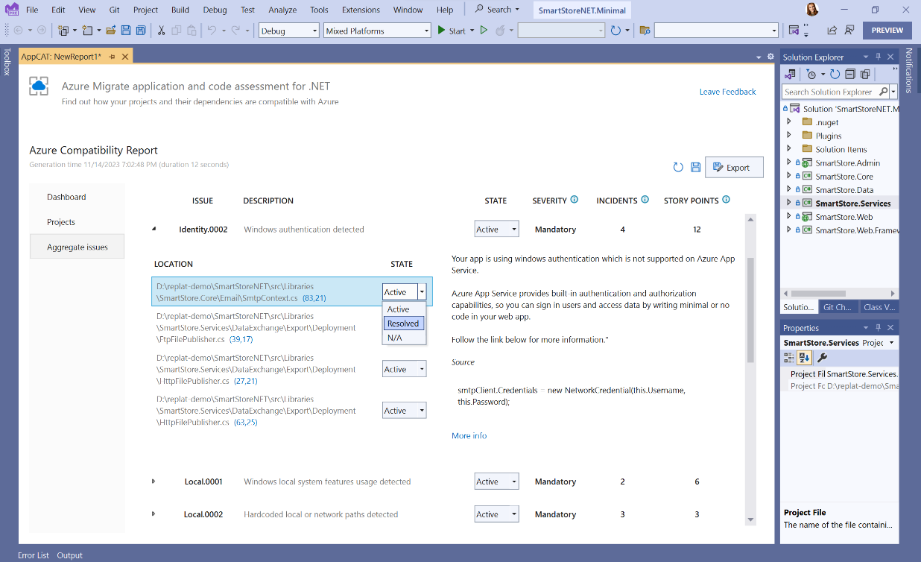
About the application and code assessment
aka.ms/appcat/dotnet
Separate tool for .NET, available as
VS extension aka.ms/appcat/dotnet/vs
.NET CLI tool aka.ms/appcat/dotnet/cli
Provides interactive compatibility report
and exports to HTML, JSON, and CSV
There is a similar separate CLI tool for Java: aka.ms/appcat/java

Slide 8

Demo

Slide 9
Try application and code assessment and give us your feedback!
aka.ms/appcat/dotnet

